Slide 1
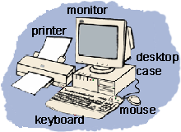
Technology 3
Bits & Bytes

Slide 2
Bits and Bytes
Did you know that all of the information that travels through your computer is based on two commands?
The only data that a computer can understand is on and off.
But, the millions of combinations of those two commands given in series are what make a computer work.

Slide 3
Bits and Bytes
Remember the power supply that is inside your computer and how it sends electricity to all of the components? That electricity is what creates an on signal.
The memory chips inside your computer are divided into thousands of tiny compartments called bits.
Each bit has an electronic switch or gate. On means the gate is open and letting electricity go through.

Slide 4
Bits and Bytes
The computer reads on or open switches as a number 1.
Closed gates are off because the electricity is blocked and cannot get through. The computer reads off bits as 0.
It is by grouping these bits together to form a series of 1/0 commands, that data is formed.

Slide 5
Bits and Bytes
The computer reads on or open switches as a number 1.
Closed gates are off because the electricity is blocked and cannot get through. The computer reads off bits as 0.
It is by grouping these bits together to form a series of 1/0 commands, that data is formed.

Slide 6
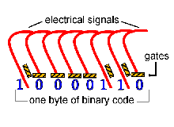
Bits and Bytes
Eight bits are grouped together to form a byte.
In this group of eight, there are 256 possible combinations of 1/0.
The grouping of 1/0 within a byte is called Binary Code.

Slide 7
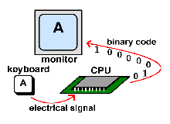
Bits and Bytes
Here's an example of the Binary Code in action:

Slide 8
KB, MB & GB
KB = kilobyte = about 1,000 bytes
MB = megabyte = about 1,000 KB
= about 1,000,000 bytes
GB= gigabyte = about 1,000 MB
= about 1,000,000 KB
= about 1,000,000,000 bytes

