Slide 1
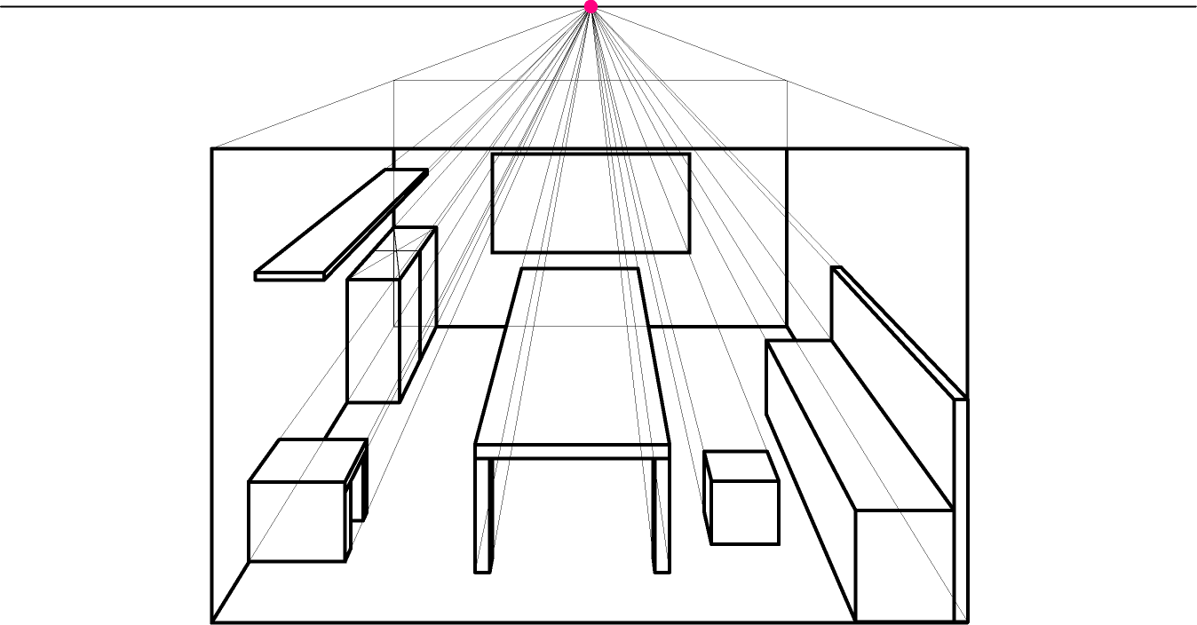
LEARNING OBJECTIVES : To understand how to estimate depths in one point perspective
To understand how to find the centre of an object in one point perspective.
One point perspective
One point perspective is a way of drawing where all forms vanish to one vanishing point somewhere on the horizon.
© F Winkworth 2008

Slide 2
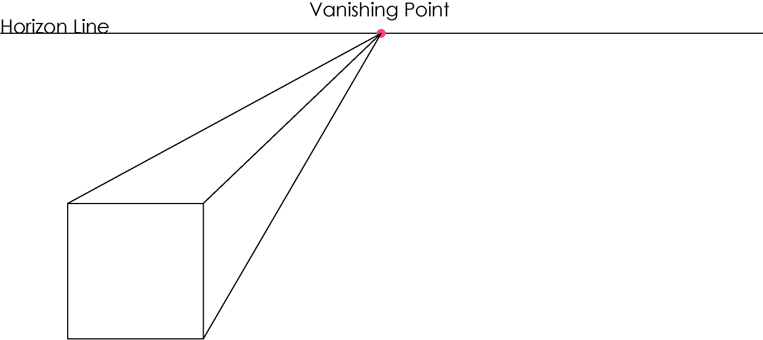
LEARNING OBJECTIVES : To understand how to estimate depths in one point perspective
To understand how to find the centre of an object in one point perspective.
One point perspective – estimating the depth of an object
Draw a horizon line and vanishing point on a fresh page. Draw a 60mm square on the page and draw orthagonals from the corners.
© F Winkworth 2008

Slide 3
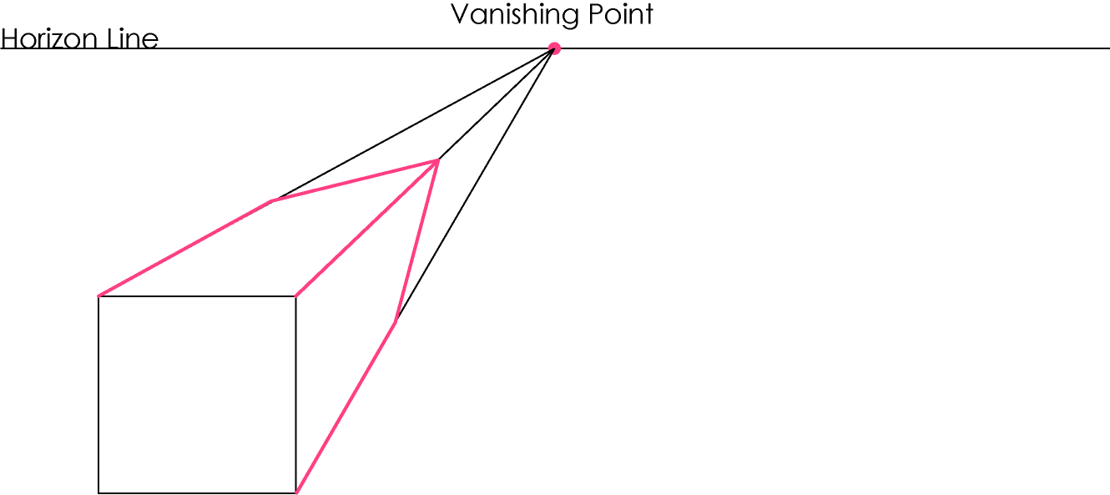
LEARNING OBJECTIVES : To understand how to estimate depths in one point perspective
To understand how to find the centre of an object in one point perspective.
One point perspective – estimating the depth of an object
Because forms get smaller or converge as they reach the vanishing point, it is impossible to measure the depth of an object accurately. Measure 60mm along each of your orthagonals and join the lines up to create a complete form. Does it look like a cube?
© F Winkworth 2008

Slide 4
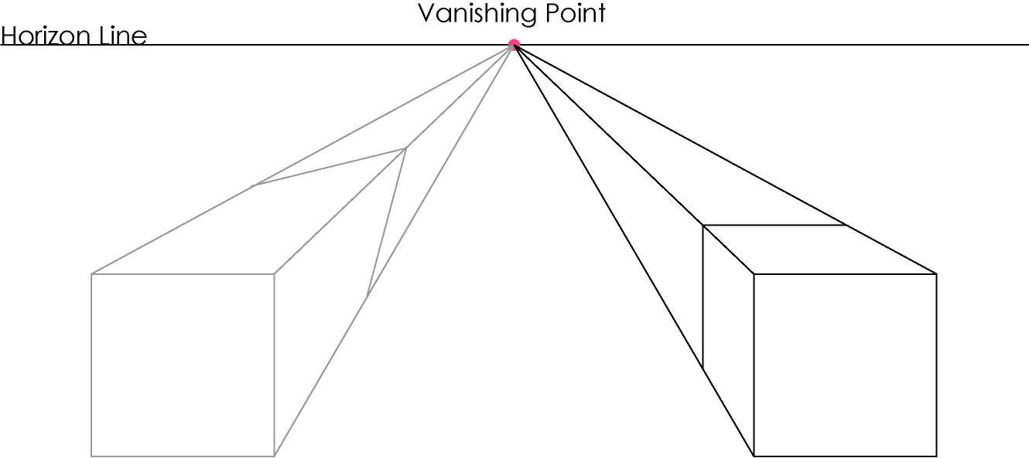
LEARNING OBJECTIVES : To understand how to estimate depths in one point perspective
To understand how to find the centre of an object in one point perspective.
One point perspective – estimating the depth of an object
Because of this, we have to estimate where a form ends and draw a horizontal and/or vertical line between the orthagonals by eye. Draw another 60mm square and draw in the orthagonals. Draw a horizontal, then vertical line to show where the form ends.
© F Winkworth 2008

Slide 5
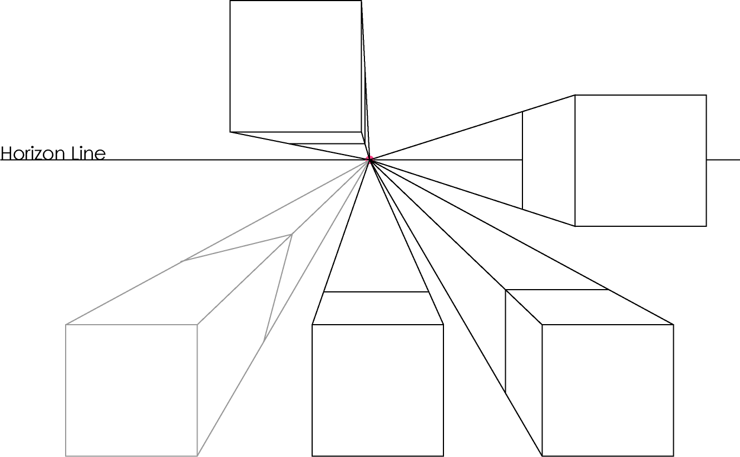
LEARNING OBJECTIVES : To understand how to estimate depths in one point perspective
To understand how to find the centre of an object in one point perspective.
One point perspective – estimating the depth of an object
Where you estimate the form to end will depend on where it is on the page in relation to the vanishing point. The closer it is to the vanishing point, the more foreshortened it will be.
© F Winkworth 2008

Slide 6
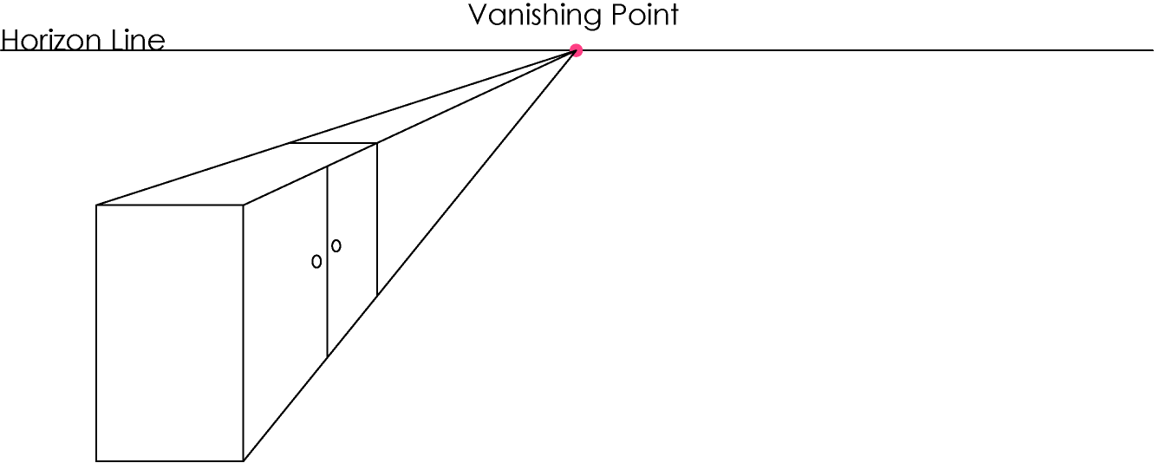
LEARNING OBJECTIVES : To understand how to estimate depths in one point perspective
To understand how to find the centre of an object in one point perspective.
One point perspective – finding the centre of an object
Sometimes when you draw an object in one point perspective you will need to find the centre of one of the sides. It is difficult to estimate this, but there is an easy way to accurately find the centre point.
© F Winkworth 2008

Slide 7
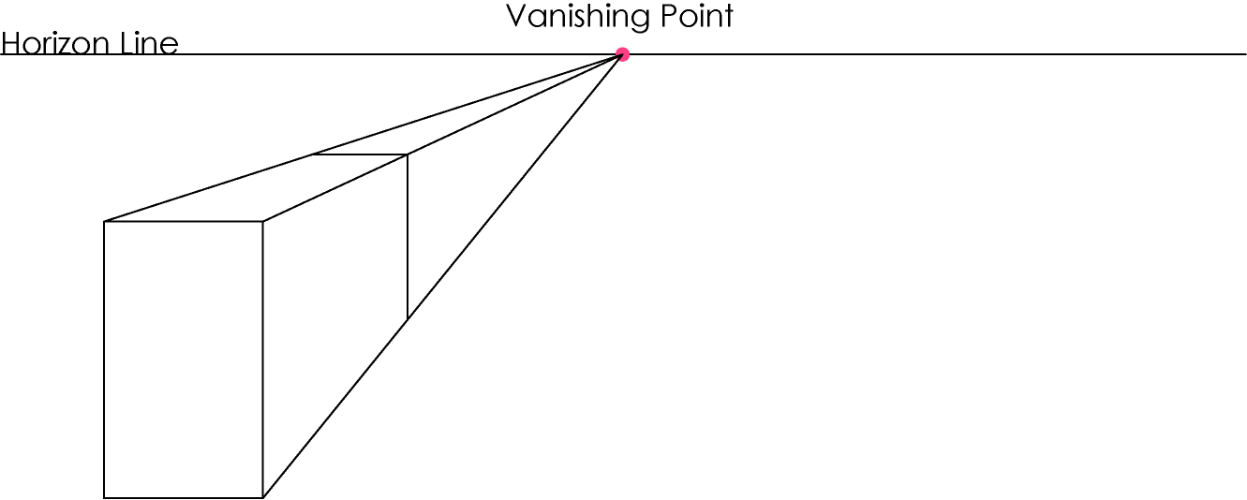
LEARNING OBJECTIVES : To understand how to estimate depths in one point perspective
To understand how to find the centre of an object in one point perspective.
One point perspective – finding the centre of an object
Draw a rectangle, draw in the orthagonals, then the horizontal and vertical lines to complete the shape.
© F Winkworth 2008

Slide 8
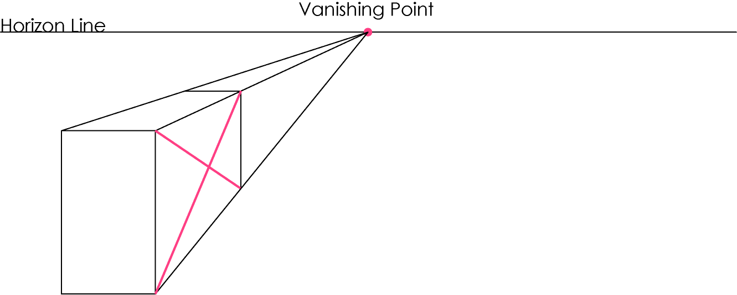
LEARNING OBJECTIVES : To understand how to estimate depths in one point perspective
To understand how to find the centre of an object in one point perspective.
One point perspective – finding the centre of an object
Draw a cross from corner to corner on the side of the form. Where the two lines meet is the exact centre of the side. This is true for any four sided shape.
© F Winkworth 2008

Slide 9
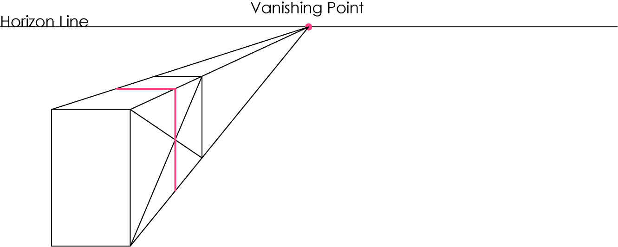
LEARNING OBJECTIVES : To understand how to estimate depths in one point perspective
To understand how to find the centre of an object in one point perspective.
One point perspective – finding the centre of an object
Draw a vertical line through the point where the lines meet, then complete the form with a horizontal line. You have now divided your form in half.
© F Winkworth 2008

Slide 10
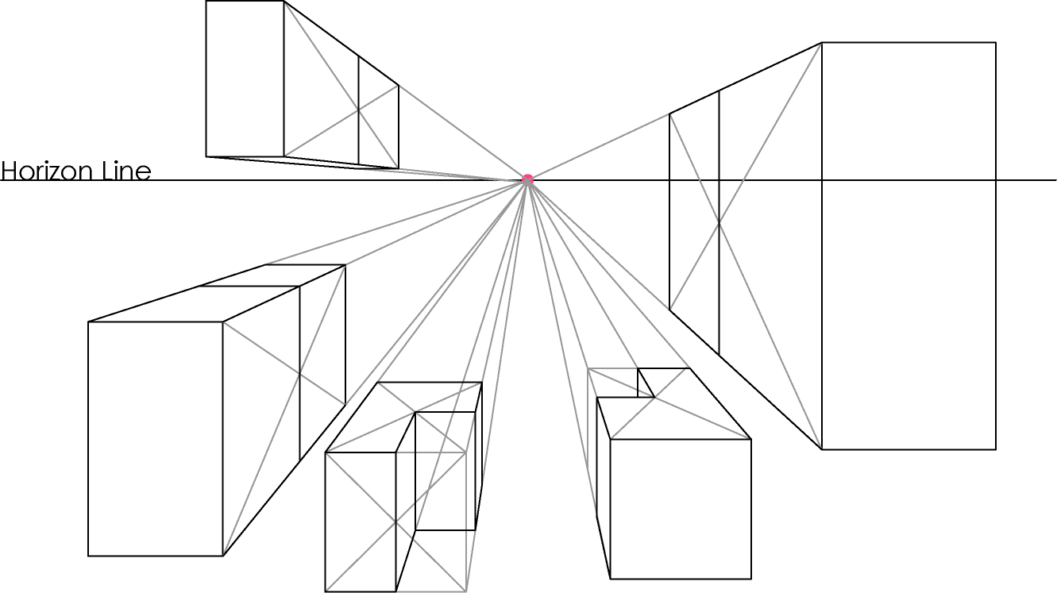
LEARNING OBJECTIVES : To understand how to estimate depths in one point perspective
To understand how to find the centre of an object in one point perspective.
One point perspective – finding the centre of an object
Practice by drawing several more forms of different sizes on your page and dividing them in half.
Extension : try drawing the L-shaped forms using the same method.
© F Winkworth 2008

Slide 11
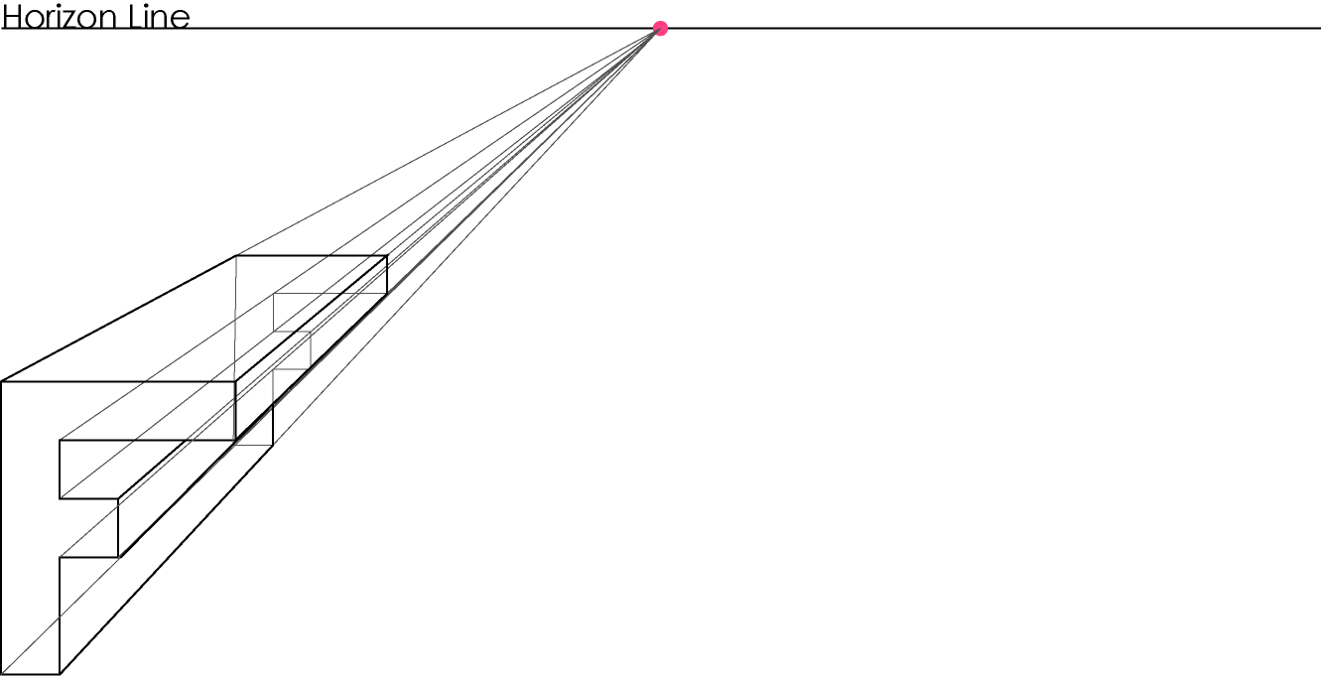
LEARNING OBJECTIVES : To understand how to estimate depths in one point perspective
To understand how to find the centre of an object in one point perspective.
One point perspective – further exercise
Draw your initial in block capitals on the page. Use one point perspective to project it towards the vanishing point. See if you can do your other initials too. Then shade the letters. Remember, colours appear paler the farther they are from us.
© F Winkworth 2008

