Slide 1
Christmas Tree Challenge
Art 1201

Slide 2
For this project, you will have to create your own handmade Christmas Tree.
You can use supplies that we have around the classroom and anything that you can recycle.
Your Christmas tree will be a sculpture in-the-round that is freestanding.
A sculpture in-the-round is a 3-dimensional sculpture that can be viewed from all sides.

Slide 3
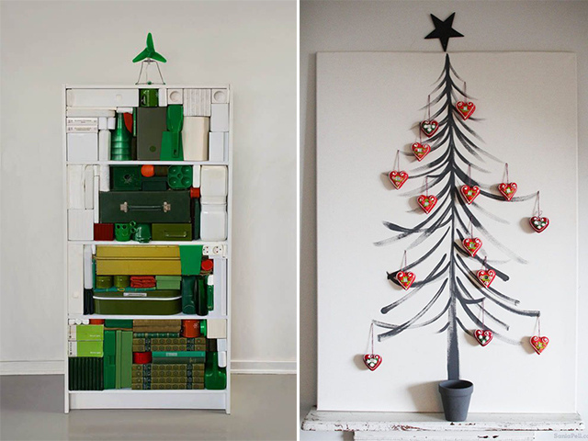

Slide 4
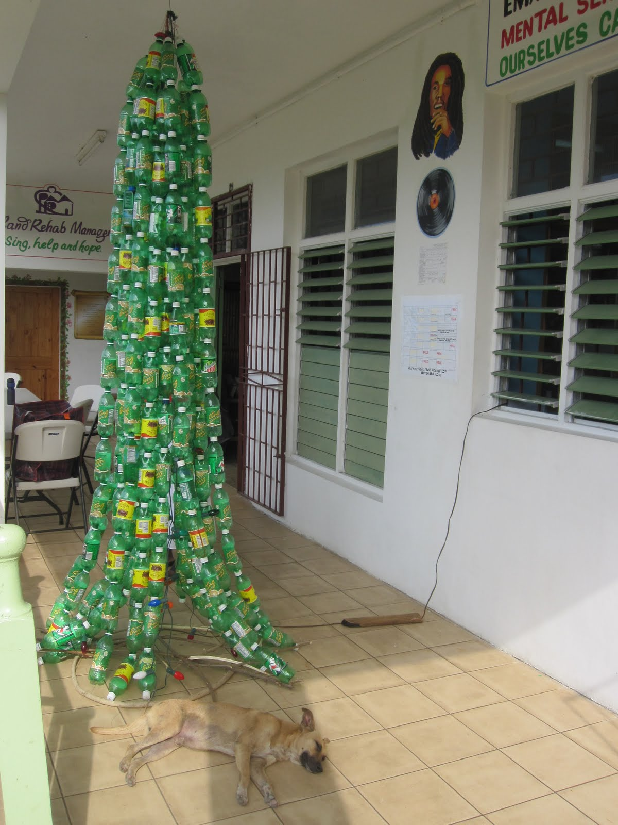

Slide 5
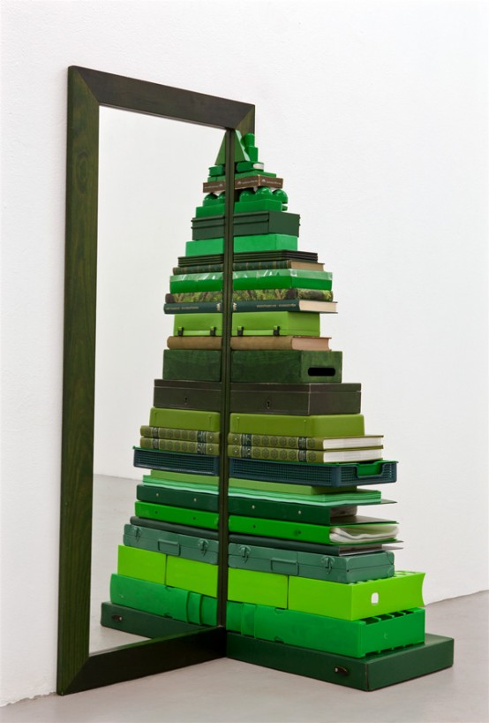

Slide 6
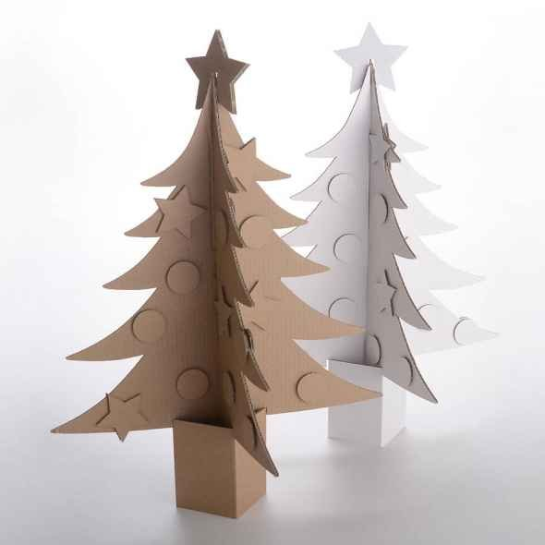

Slide 7
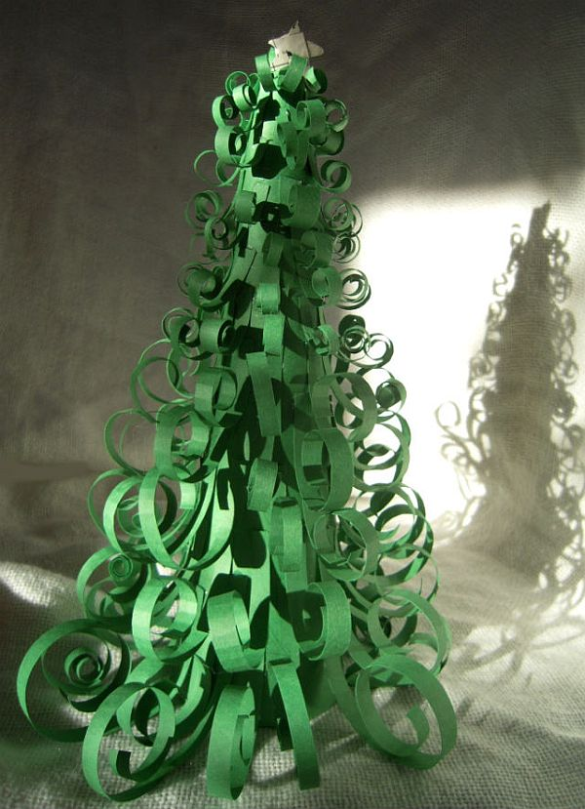

Slide 8
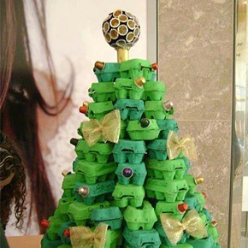

Slide 9
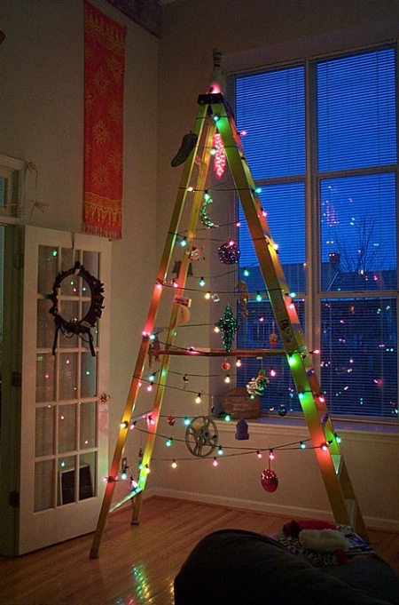

Slide 10
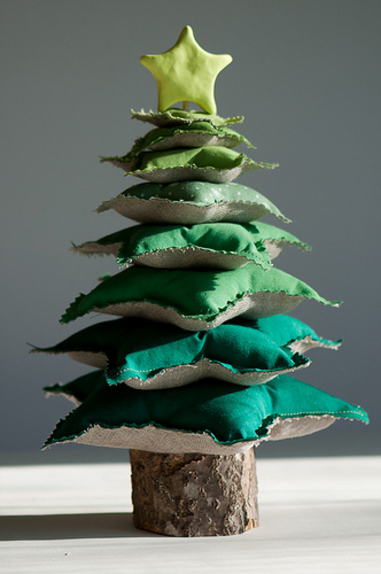

Slide 11
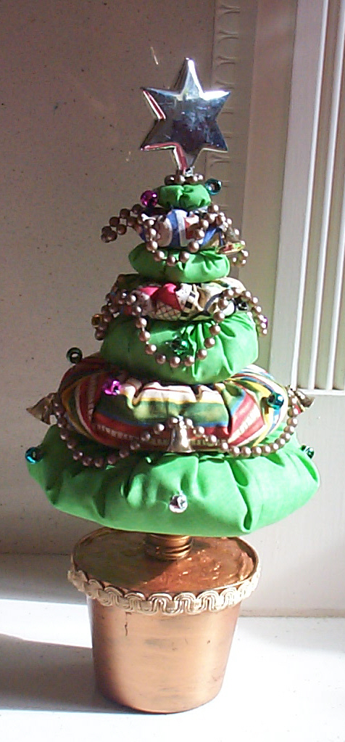

Slide 12
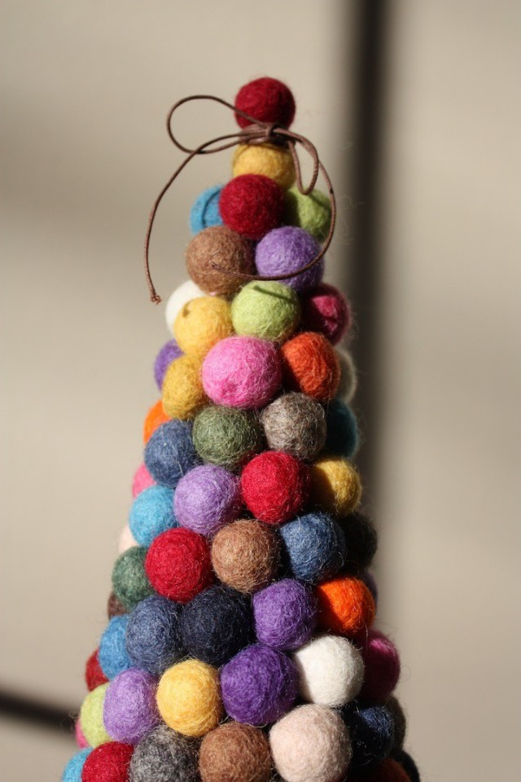

Slide 13
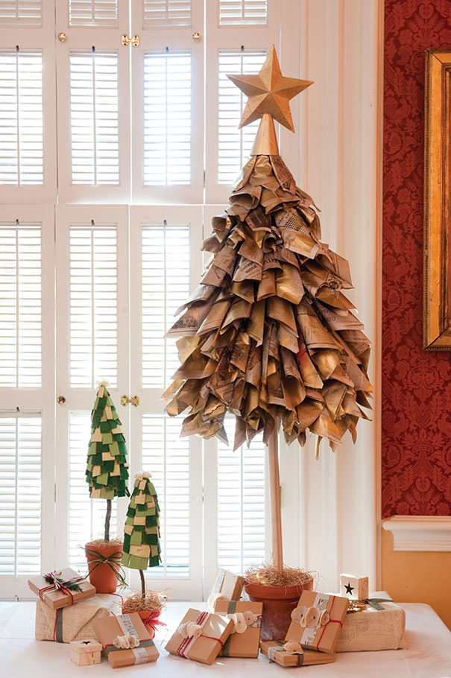

Slide 14
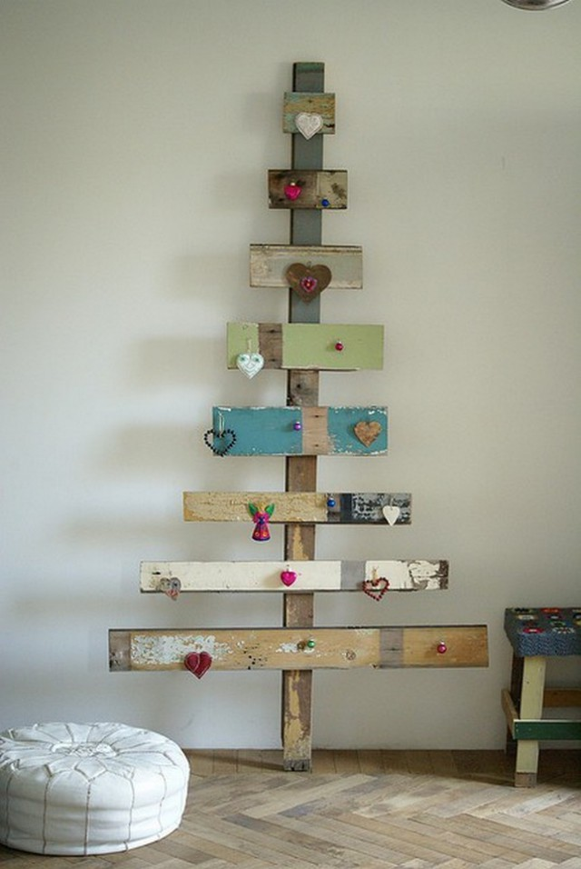

Slide 15
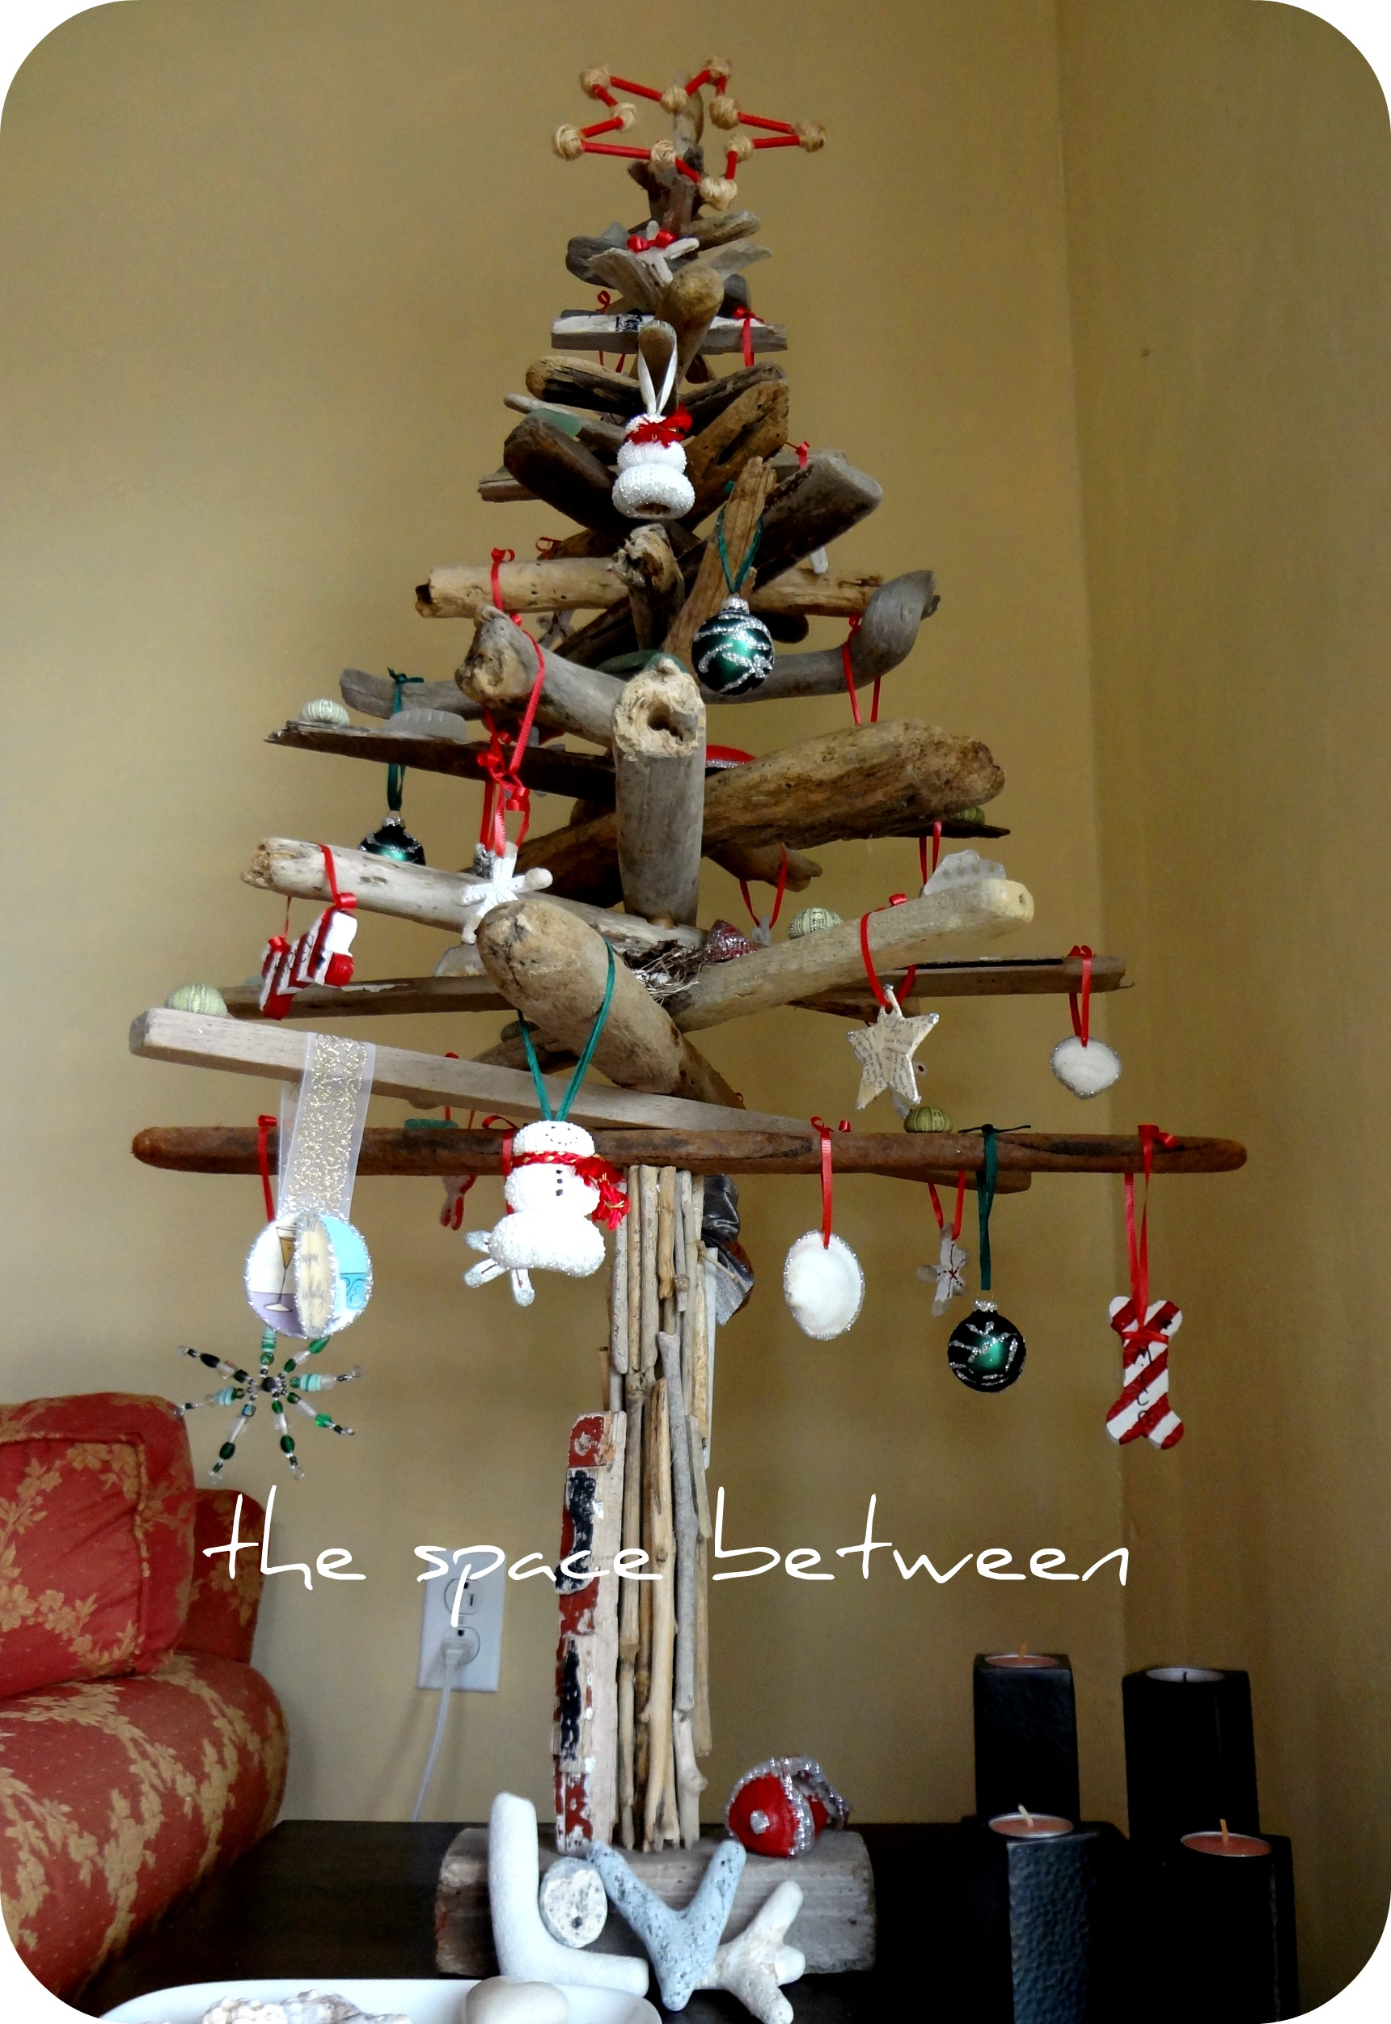

Slide 16
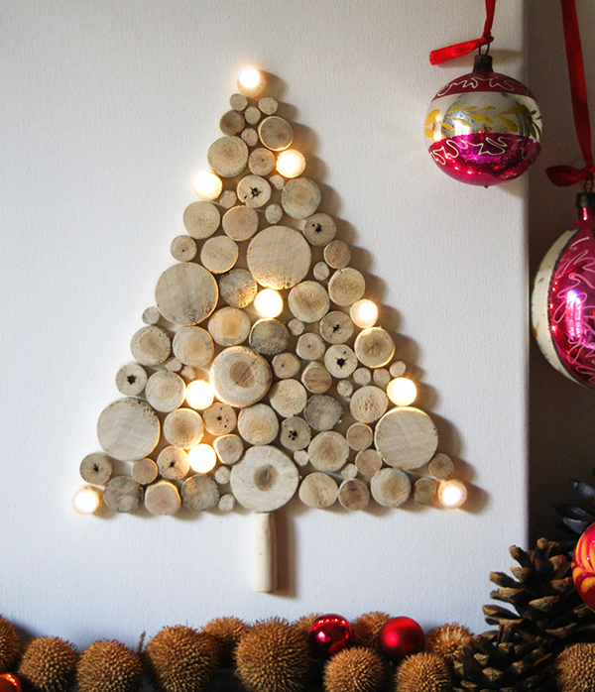

Slide 17
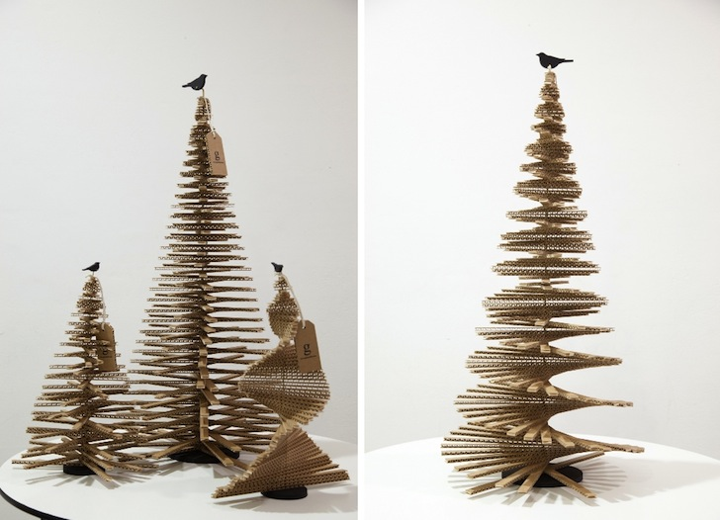

Slide 18
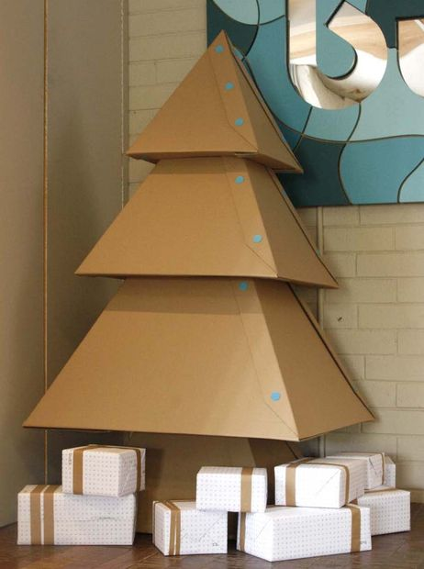

Slide 19
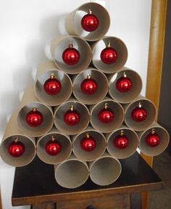

Slide 20
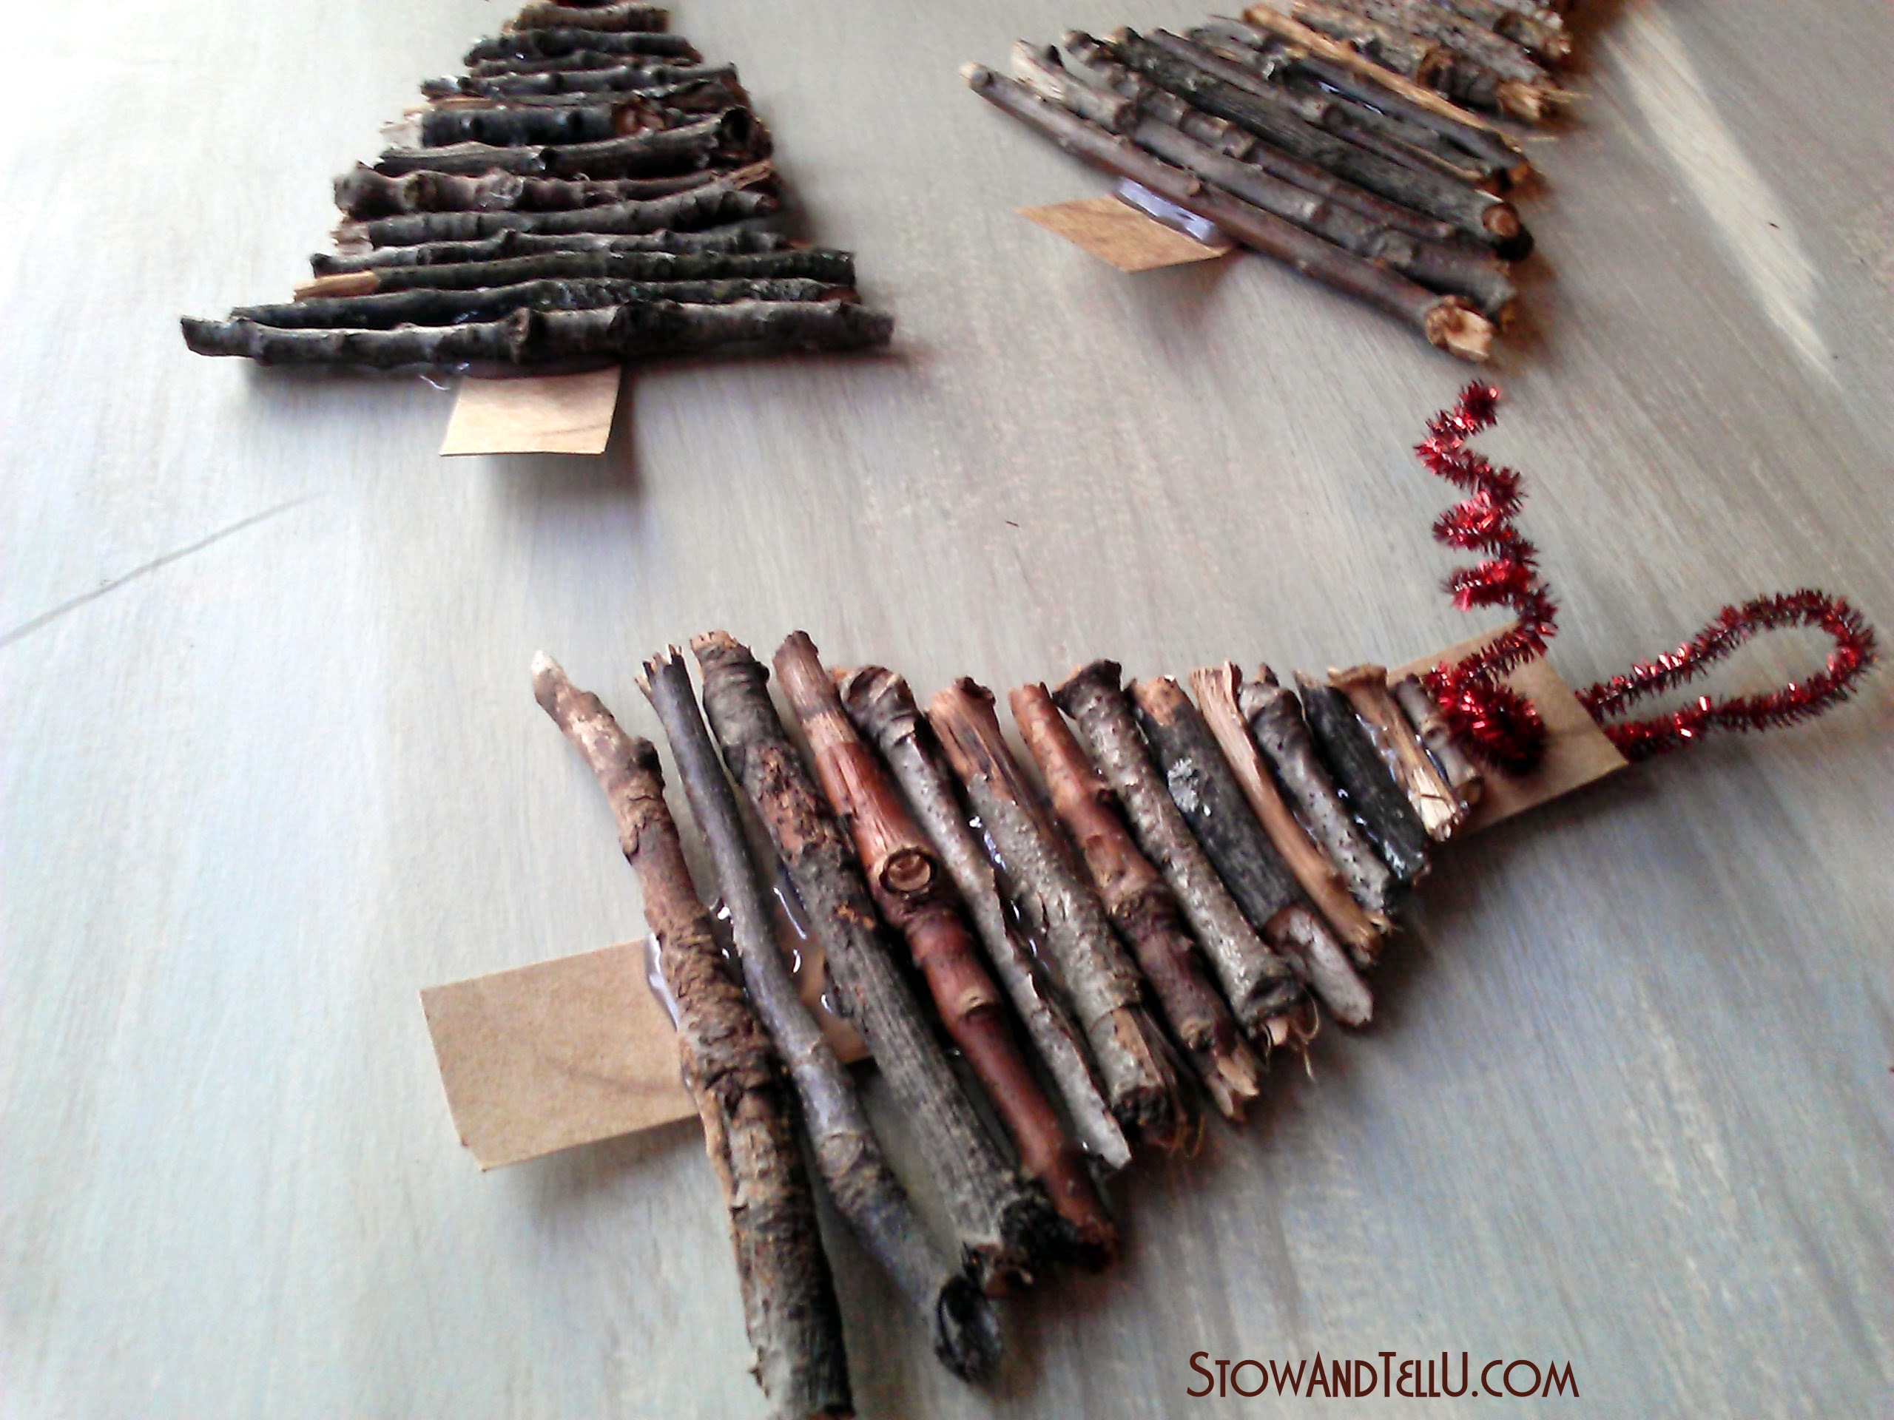

Slide 21
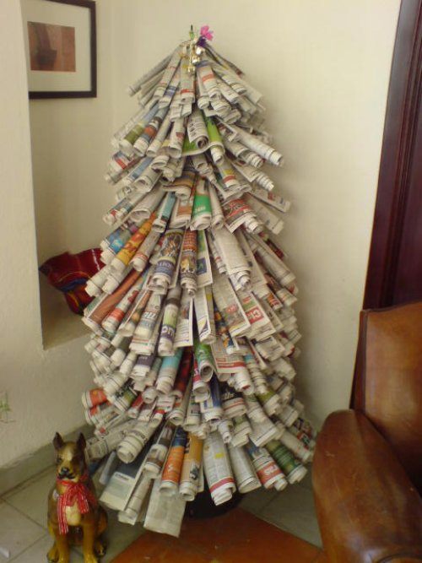

Slide 22
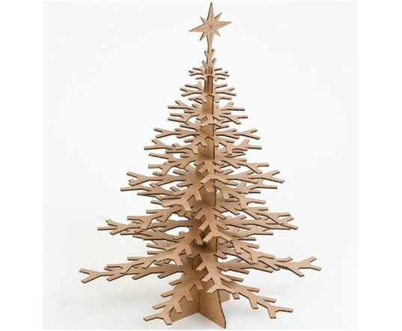

Slide 23
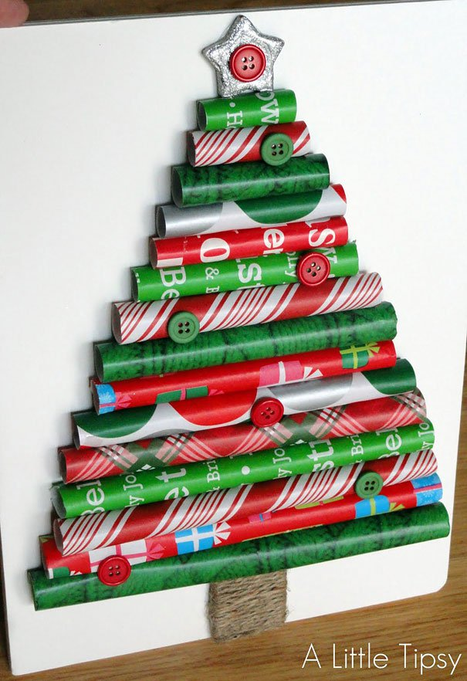

Slide 24
Christmas Tree Challenge:
For this project, you will get in groups of 2 or 3 to construct a Christmas tree (you can also work on your own if you wish).
Christmas Tree requirements: - Tree must be a minimum of 18 inches high - Tree must be a sculpture in-the-round which is freestanding - Tree must be colourful, bright, and cheerful - F Tree must be constructed with recycled materials (although decorations/accessories may be added)

