Slide 1
One Point Perspective Letters
Draw your horizon line and vanishing point. Draw a letter ‘A’ inside a rectangular box.
© F Winkworth 2008

Slide 2
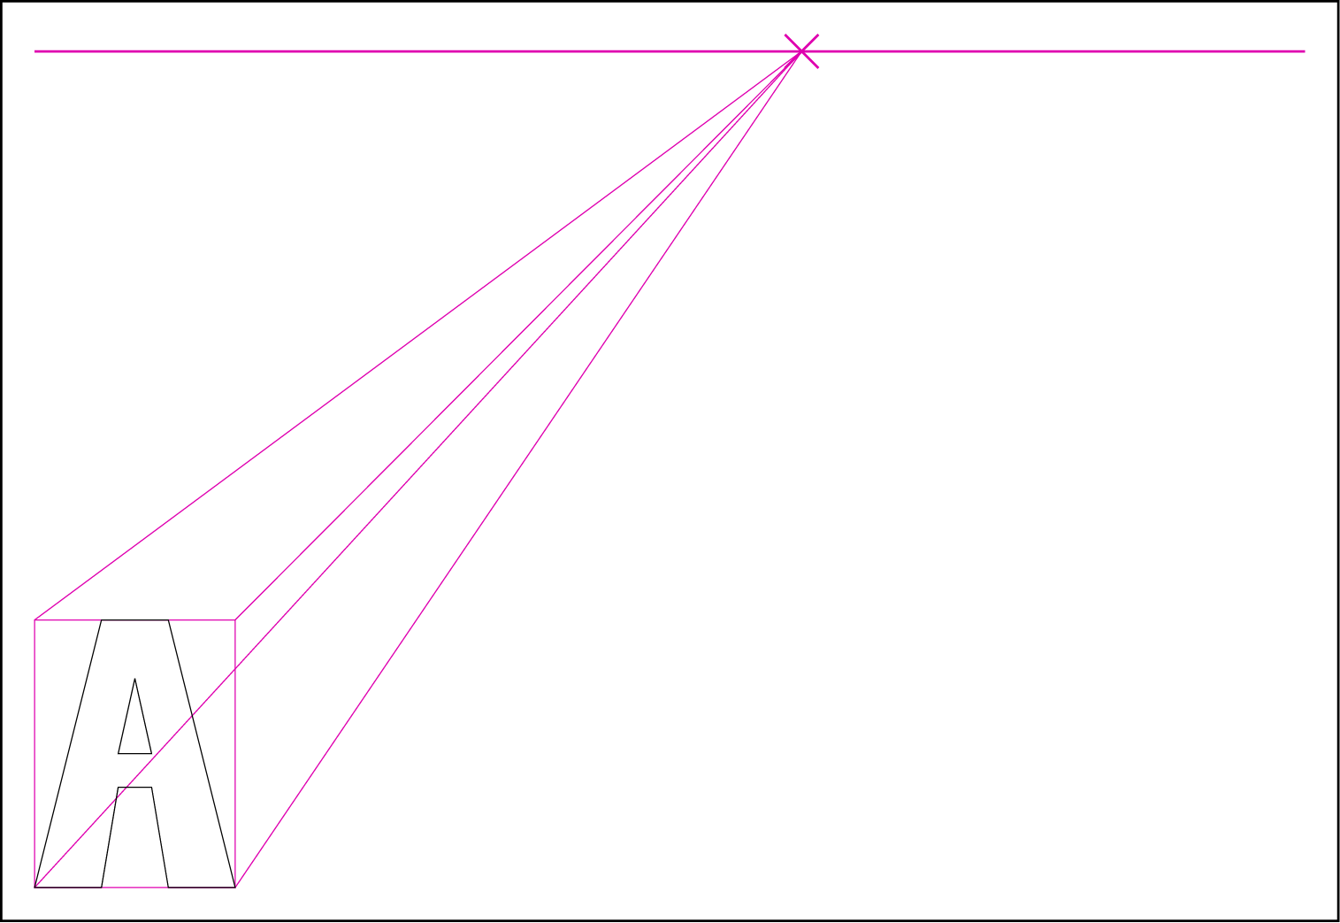
One Point Perspective Letters
Draw orthagonals from each corner of the rectangle
© F Winkworth 2008

Slide 3
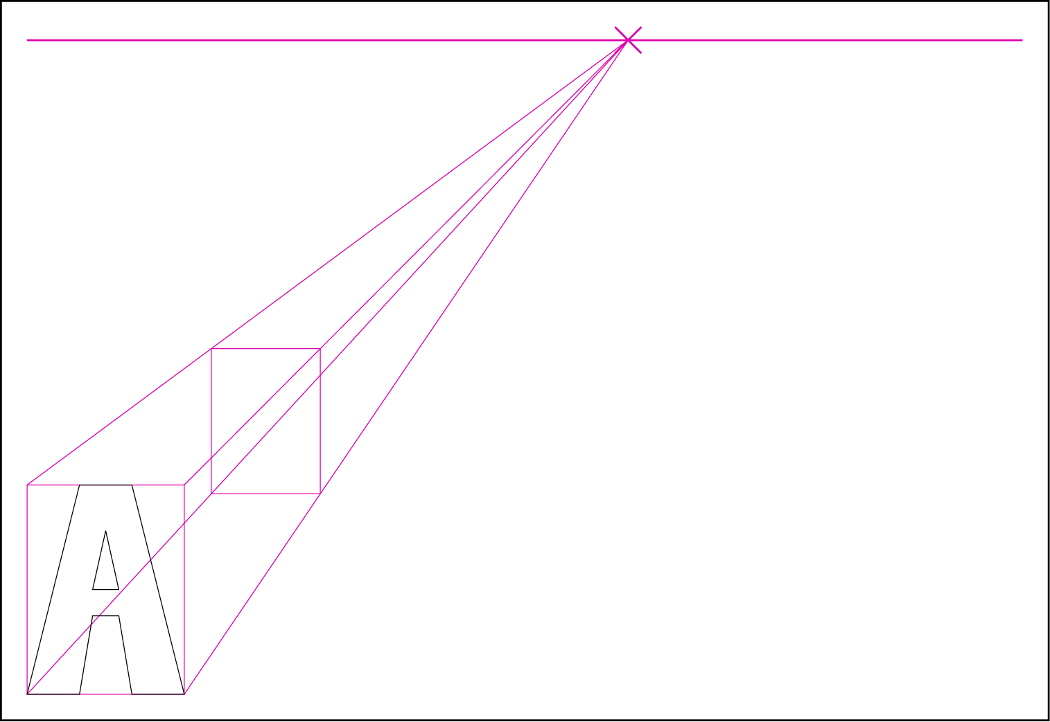
One Point Perspective Letters
Draw another rectangle between the orthagonals where you want the letter to end.
© F Winkworth 2008

Slide 4
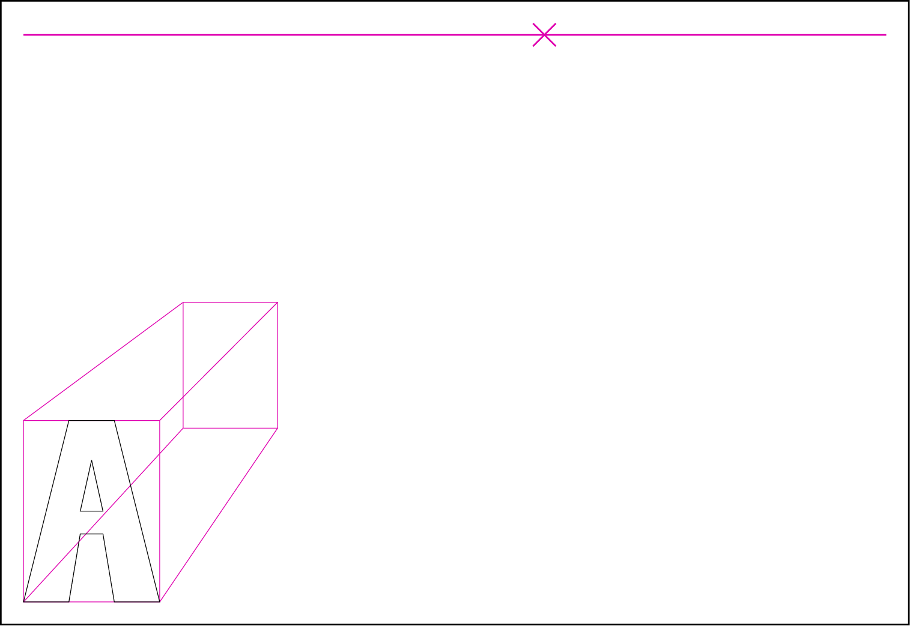
One Point Perspective Letters
Rub out the lines you no longer need.
© F Winkworth 2008

Slide 5
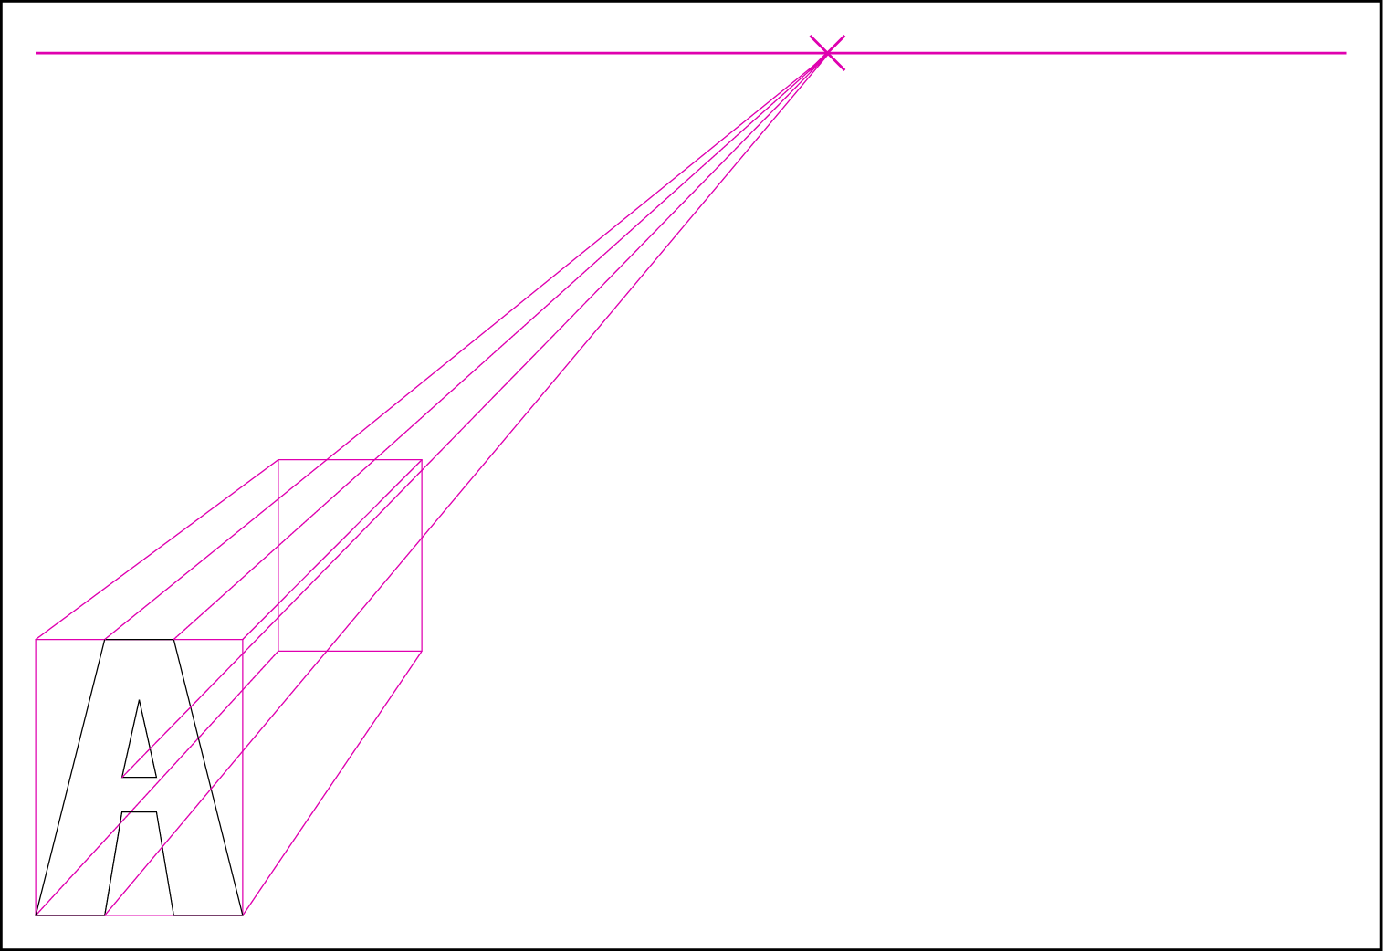
One Point Perspective Letters
Draw orthagonals from the corners of the letter ‘A’ to make the sides you will be able to see when the shape is complete.
© F Winkworth 2008

Slide 6
One Point Perspective Letters
Join up the lines to draw the letter on the back rectangle.
© F Winkworth 2008

Slide 7
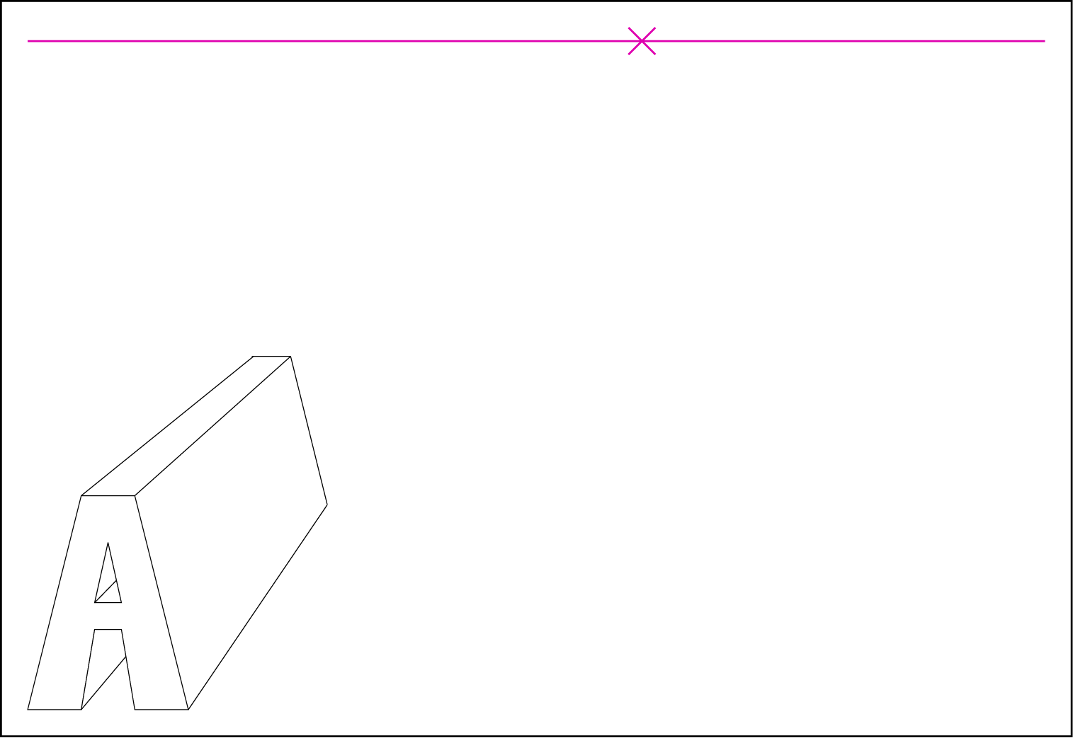
One Point Perspective Letters
Rub out the bits of line you no longer need.
© F Winkworth 2008

Slide 8
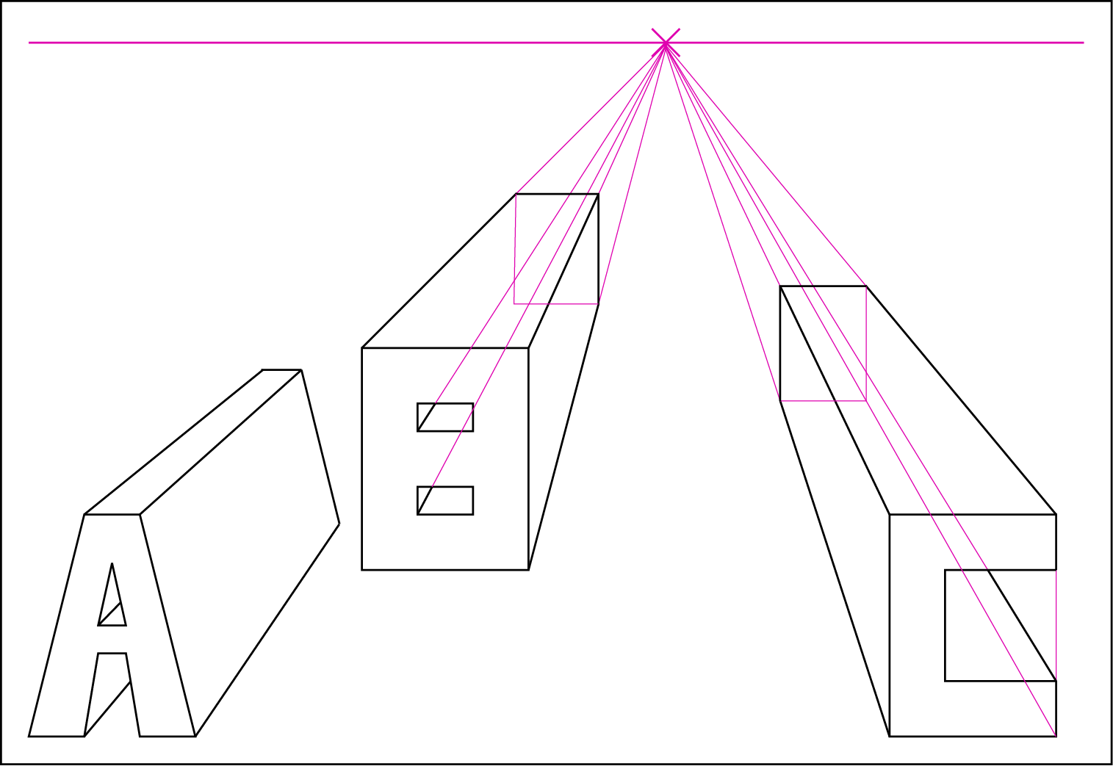
One Point Perspective Letters
Draw three letters of your choice in one point perspective on a page. Use block letters rather than curves and make sure you draw the letter in a rectangle first.
© F Winkworth 2008

